Slide 1
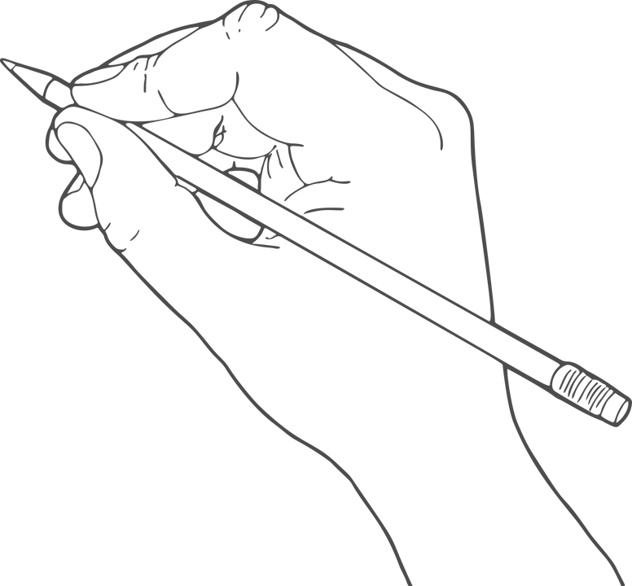
Narrative Story Grammar
w2L
Learn to Write
Write to Learn
Year X, Write to Learn

Slide 2
Plan Narrative Story Grammar
LESSON 1

Slide 3
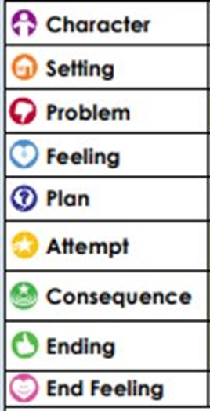
Teacher and students read together.
Ask discussion question
Briefly note examples of ways of adding detail
APK
What are the components of Story Grammar?
1-1
Notes:
Point to the dates on the timeline from the 700s to 1000 CE. Explain to students that they will be reading about a time in history that covers approximately three hundred years of events. Students will learn about the early history of the Vikings, from their invasions of Europe to their settlement in North America.

Slide 4
I will plan a full narrative using Story Grammar
Teacher and students read together.
TODAY’S LEARNING GOAL
1-2

Slide 5
Teacher and students read together.
Teacher and students read together.
Read Definition & Example
Ask Question
REVIEW,
What is an appositive?
Which of the following is an appositive?
An appositive is an additional piece of information that follows a noun.
Usually this is a noun, however, feel free to try this out on a person place or thing!
Here are some examples:
Youseff, on his camel, travelled far and wide to find the hidden treasure.
Youseff, with his long beard and dark eyes, mischievously grinned at the sight of gold.
1. The young boy was not ready to fight. He was kindhearted and naïve.
2. The naïve and kindhearted boy was not ready to fight.
3. The boy, naïve and kindhearted, was not ready to fight.
1-1

Slide 6
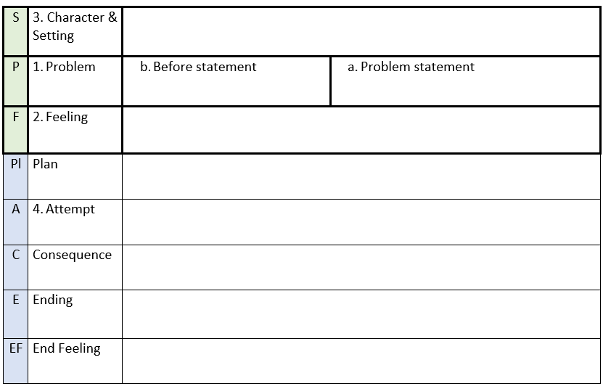
Teacher and students read together.
Teacher and students read together.
Read Definition & Example
Ask Question
CONCEPT DEVELOPMENT
How to order your planning:
What part of the story do I plan first?
When planning a narrative, I should begin with _______.
1-1
Notes:
Melbourne, the capital city of Victoria, is the home of the MCG

Slide 7
On your whiteboards, brainstorm ideas about this picture.
What story/ideas can you think of from this picture?

Slide 8
Teacher Models Left Example, Students Complete Right Example
Model Left
Read example
Students complete
GUIDED PRACTICE
Planning the Problem
STEPS
1. Problem
a. Problem Statement
b. Before Statement
2. Feeling
3. Character/Setting
Who
Doing what
When
Where
Why
*Remember to make your plan short and to the point. Ideally, by the end of this week you should be able to plan a whole narrative in 10 minutes.
1-1
Notes:
Model dialogue
Shane suggestion: Use it for feeling (for example internal voice of character)

Slide 9
Teacher Models Left Example, Students Complete Right Example
Model Left
Read example
Students complete
GUIDED PRACTICE
Planning the Feeling
STEPS
4. Attempt
5.Plan
6. Consequence
7.Ending
8.Feeling
1-1
Notes:
Model dialogue
Shane suggestion: Use it for plan (character's discussing what to do to solve the plan)

Slide 10
Teacher and students read together.
Read passage and Example
Ask question
SKILL/CONCEPT CLOSURE
Does your partners story make sense?
Read your plan to a partner.
1-1

Slide 11
Write Narrative Story Grammar
LESSON 2

Slide 12
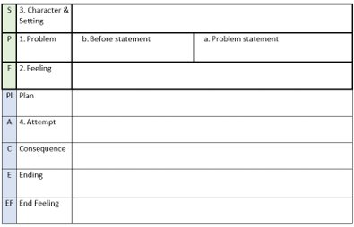
Teacher and students read together.
Briefly note examples of ways of adding detail
APK
These are the components of Story Grammar.
1-1

Slide 13
Teacher and students read together.
Teacher and students read together.
Read Definition & Example
Ask Question
REVIEW,
What is S.P.F.?
What is included in a S.P.F. plan?
Planning is the most important part of the writing process.
The order in which we plan, can have a big impact on how cohesive our narrative can be.
What is S.P.F. in Story Grammar?
A good way to start a narrative is by introducing the setting, problem and feeling.
A problem is anything that goes wrong in a narrative.
A problem is made up of two parts:
1. A sentence(s) that states problem.
2. A sentence(s) stating what is happening just before the start of the problem
1. Setting/characters, problem, feelings
2. Setting/characters, problem and attempt
3. Setting, characters and problem.
1-1

Slide 14
Teacher and students read together.
Teacher and students read together.
Read Answer
REVIEW,
What is S.P.F.?
What is included in S.P.F. plan?
What is S.P.F. in Story Grammar?
A good way to start a narrative is by introducing the setting, problem and feeling.
A problem is anything that goes wrong in a narrative.
A problem is made up of two parts:
A sentence(s) that states problem.
A sentence(s) stating what is happening just before the start of the problem
1. Setting/characters, problem, feelings
2. Setting/characters, problem and attempt
3. Setting, characters and problem.
1-1

Slide 15
Teacher and students read together.
Teacher and students read together.
Read Definition & Example
Ask Question
REVIEW,
What is PL.A.C.E.
What is included in PL.A.C.E.?
What is PL.A.C.E.?
The S.P.F. in a story is usually followed by PL.A.C.E.
PL.A.C.E. means:
Plan
Attempt
Consequence
Ending / End Feeling
These elements need to all be related to one another and the problem of the story.
The attempt must match the plan, and the consequence is a result of the attempt.
1. PL.A.C.E. explains the place or setting of the narrative
2. Plan, attempt, consequence, ending/ end feeling
3. Problem, plan and ending.
1-1

Slide 16
Teacher and students read together.
Teacher and students read together.
Answer Question
REVIEW,
What is PL.A.C.E.
What is included in PL.A.C.E.?
What is PL.A.C.E.?
The S.P.F. in a story is usually followed by PL.A.C.E.
PL.A.C.E. means:
Plan
Attempt
Consequence
Ending / End Feeling
These elements need to all be related to one another and the problem of the story.
The attempt must match the plan, and the consequence is a result of the attempt.
1. explains the place or setting of the narrative
2. Plan, attempt, consequence, ending/ end feeling
3. Problem, plan and ending.
1-1

Slide 17
I will write a full narrative using Story Grammar
Teacher and students read together.
TODAY’S LEARNING GOAL
1-2

Slide 18
Task
S | 3. Character & Setting
P | 1. Problem | b. Before statement | a. Problem statement
F | 2. Feeling
Pl | 5. Plan
A | 4. Attempt (Successful)
C | 6. Consequence
E | 7. Ending
EF | 8. End Feeling
Notes:
Teacher to input spf plan from previous lesson - review

Slide 19
Plan, attempt and consequence
Pl | 5. Plan
A | 4. Attempt (Successful)
C | 6. Consequence
Attempt (Teacher to model):
Sentence(s) saying what character(s) think of doing for the plan.
- Internal voice
Sentence(s) telling what characters did from plan
+ Dialogue
+ Internal thoughts
Sentence(s) that describe feeling
Sentence(s) that name feeling
+ Internal voice
Plan, attempt, consequence (Teacher to model):
Notes:
Internal voice and dialogue, review puntuation

Slide 20
Ending and end feeling
E | 7. Ending
EF | 8. End Feeling
Sentence(s) that tell what happened after the problem is solved
Sentence(s) that tell what the character(s) feel or think about the narrative
Ending and end feeling (Teacher to model):

Slide 21
Your task today
Write your narrative using your SPF and PLACE.
Don't forget:
Appositives
Dialogue
Ving/Ved clauses
Subordinating conjunctions
Punctuation
Adverbs and fronted adverbials

Slide 22
Plan - Narrative Story Grammar
Lesson 3

Slide 23
I will plan a basic SPF PLACE I will add features to my plan, such as dialogue
Teacher and students read together.
TODAY’S LEARNING GOAL
1-2

Slide 24
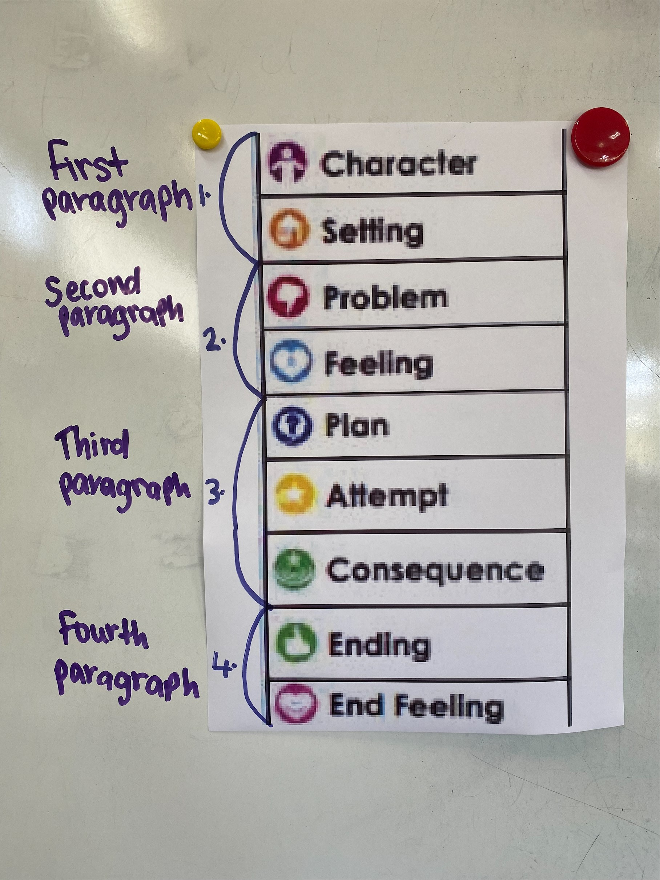
Teacher and students read together.
Planning a basic SPFPLACE
Teacher and students read together.
Read Definition & Example
Ask Question
CONCEPT DEVELOPMENT
When planning a narrative what section do you plan first?
Today we are going to write the first two paragraphs of our narrative. This means we are introducing the character/setting and the problem/feeling.
When planning a narrative, I should plan the ___________ first.
1-1

Slide 25
Here is image of an event happening. There is a lot of information in this image and we can use it to create a story. Let's brainstorm as a class:
What led up to these events?
Who are these characters?
What are some of the details that you notice that could influence your story?
Some extra questions we could ask:
What could the problem be?
When could this event be happening?
What are some descriptions that you could use?
Can we use any of our prior knowledge?

Slide 26
S | 3. Character & Setting
P | 1. Problem | b. Before statement | a. Problem statement
F | 2. Feeling
Pl | 5. Plan
A | 4. Attempt (Successful)
C | 6. Consequence
E | 7. Ending
EF | 8. End Feeling
Notes:
Teacher to model filling in the plan with very minimal writing. Only include essential information from the class and emphasise that there should only be enough information to write a sentence.

Slide 27
Your task today
Using the provided picture prompt, plan a narrative using the SPFPLACE template.
Finish your plan within 10 minutes, making sure you have written something in each box. It only needs to be a couple of dot points.
With the time remaining, read through your plan and decide what extra details you can add.
For example,
- Who, where, when, why, how (character/setting)
- 5 senses – hearing, taste, touch, smell, seeing
- Adjectives, adverbs and descriptive phrases
- Ideas for complex sentences
- Vocabulary

Slide 28
Write - Narrative Story Grammar
Lesson 4

Slide 29
Writing a 'V-ing' clause
CFU Question: Write a 'V-ing' clause for the following sentence.
She travelled to school.
The boy cheered his team on.
The boy cheered his team on, screaming and chanting.
Steps:
1. Read the sentence.
2. Write a 'V-ing' clause that matches the subject and predicate before the independent clause.
3. Include a comma before or after the V-ing clause, and then write the rest of the sentence.

Slide 30
I will write my narrative using SPF PLACE from my plan
Teacher and students read together.
TODAY’S LEARNING GOAL
1-2

Slide 31
Teacher and students read together.
Writing our narrative using the plan:
Teacher and students read together.
Read Definition & Example
Ask Question
CONCEPT DEVELOPMENT
When planning a narrative what section do you plan first?
Today we are going to write a narrative using the SPF PLACE plan we created yesterday.
When planning a narrative, I should plan the ___________ first.
1-1

Slide 32
Task
S | 3. Character & Setting
P | 1. Problem | b. Before statement | a. Problem statement
F | 2. Feeling
Pl | 5. Plan
A | 4. Attempt (Successful)
C | 6. Consequence
E | 7. Ending
EF | 8. End Feeling
Notes:
Teacher to input spf plan from previous lesson - review

Slide 33
Plan, attempt and consequence
Pl | 5. Plan
A | 4. Attempt (Successful)
C | 6. Consequence
Attempt (Teacher to model):
Sentence(s) saying what character(s) think of doing for the plan.
- Internal voice
Sentence(s) telling what characters did from plan
+ Dialogue
+ Internal thoughts
Sentence(s) that describe feeling
Sentence(s) that name feeling
+ Internal voice
Plan, attempt, consequence (Teacher to model):

Slide 34
Ending and end feeling
E | 7. Ending
EF | 8. End Feeling
Sentence(s) that tell what happened after the problem is solved
Sentence(s) that tell what the character(s) feel or think about the narrative
Ending and end feeling (Teacher to model):

Slide 35
Your task today
Using your SPF PLACE, write a narrative.
When writing, remember to include:
- Who, where, when, why, how details (character/setting)
- 5 senses – hearing, taste, touch, smell, seeing
- Adjectives, adverbs and descriptive phrases
-Dialogue
- Interesting vocabulary

Slide 36
Do next session in week 10 due to planning day on Friday :)

Slide 37
Plan AND write in one lesson - Narrative Story Grammar
LESSON 5 - Georgia

Slide 38
Read Definition & Example
Ask Question
Review
Dialogue in Narratives
The jagged rocks, stretching on far into the distance, kept tripping me over and causing me to stumble.
"I need to keep looking through this barren landscape," thought Christopher. "I have to find the cure for my sister." As this thought crossed my mind, I noticed another boy walking down the nearby mountain. I dashed across the rocks to talk to him.
"Hey, please, you need to help me," panted Christopher, as he approached the boy.
"Sorry, I can't help. I don't even know who you are, " replied the boy.
"Please, my name is Christopher and I need to save my sister!" Christopher begged. The boy looked at him and nodded his head, introducing himself as Dante. Using Dante's torch, they were able to better search the mountain range and eventually, found a large hill. This hill was identical to the hill the stone was buried under. The boys stared at each other, excited.
Notice how a new paragraph is started every time a different character is speaking.
1-1
Notes:
Add notes during planning for content

Slide 39
I will plan AND write a full narrative
Teacher and students read together.
TODAY’S LEARNING GOAL
1-2

Slide 40
Teacher and students read together.
Writing our narrative using the plan:
Teacher and students read together.
Read Definition & Example
Ask Question
CONCEPT DEVELOPMENT
When planning a narrative what section do you plan first?
Today we are going to write the first two paragraphs of our narrative. This means we are introducing the character/setting and the problem/feeling.
When planning a narrative, I should plan the ___________ first.
1-1

Slide 41
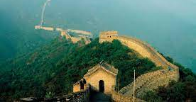
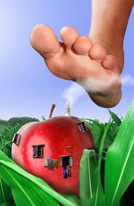
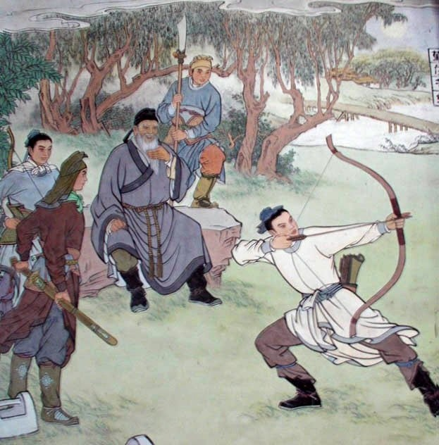
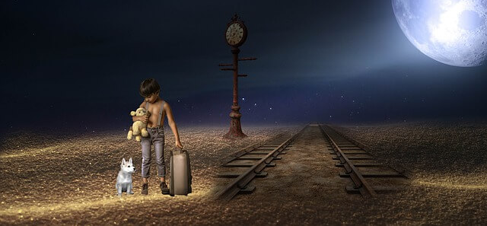
Discuss which image you're going to choose. What story line ideas do you have?

Slide 42
This is our SPF plan. You have 10 minutes to fill out your own plan.
S | 3. Character & Setting
P | 1. Problem | b. Before statement | a. Problem statement
F | 2. Feeling
Pl | 5. Plan
A | 4. Attempt (Successful)
C | 6. Consequence
E | 7. Ending
EF | 8. End Feeling

Slide 43
Write your Character and Setting paragraph
S | 3. Character & Setting

Slide 44
Write your Problem and feeling paragraph
P | 1. Problem | b. Before statement | a. Problem statement
F | 2. Feeling

Slide 45
Write your Plan, attempt and consequence paragraph
Pl | 5. Plan
A | 4. Attempt (Successful)
C | 6. Consequence
Attempt (Teacher to model):
Sentence(s) saying what character(s) think of doing for the plan.
- Internal voice
Sentence(s) telling what characters did from plan
+ Dialogue
+ Internal thoughts
Sentence(s) that describe feeling
Sentence(s) that name feeling
+ Internal voice

Slide 46
Write your Ending and end feeling paragraph
E | 7. Ending
EF | 8. End Feeling
Sentence(s) that tell what happened after the problem is solved
Sentence(s) that tell what the character(s) feel or think about the narrative

