Slide 1
Writing
Session 2 Week 9

Slide 2
Learning Intentions
Our learning goal is to:
explain the components of a fiction text in relation to story grammar.

Slide 3
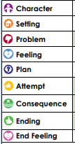
What is Story Grammar?
Story grammar is the necessary components that a fiction text needs to have to be a narrative.
CFU Question:
We arrived at the beach and laid our towels on the sand before we ran into the water.
Which element of story grammar would this sentence relate to?
Who is in the story (people, animals)
The context – (time, place, what is happening before)
The main challenge the characters have to overcome
How the character is feeling about the problem.
What the character planned or decided to do.
The plan put into action.
The result of the plan
What is the conclusion? How does the story end?
How the character feels at the end of the story.

Slide 4
Story grammar in action.
Story grammar is the necessary components that a fiction text needs to have to be a narrative.
CFU Question:
Explain and justify why the you are correct.
___________ is the ___________ because....
Notes:
Teacher to read Stellarphant: https://www.youtube.com/watch?v=YdMzJFWMYuc
Teacher puts the necessary components into the table and students explain why that component fits into story grammar.

Slide 5
Reflection
Relevance: Why am I learning about story grammar and how to identify it in a narrative?
A) I will be able to explain all the parts of a narrative.
B) I want my narrative writing to improve.
C) It is part of the required Year 3 learning.
Notes:
Students to discuss which reason is the more relevant to them

Slide 6
Writing
Session 3 Week 9

Slide 7
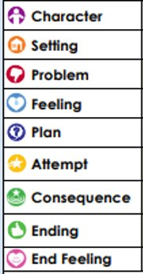
Activating Prior Knowledge
Who is in the story (people, animals)​
Context – where, when and why the story is taking place.
The main challenge the characters have to overcome​
How the character is feeling about the problem.​
What the character planned or decided to do.​
The plan put into action.​
The result of the plan
What is the conclusion? How does the story end?​
How the character feels at the end of the story. ​

Slide 8
Learning Intentions
Our learning goal is to:
write a setting

Slide 9
What is S.P.F.? (Setting, Problem, Feeling)
A good way to start a narrative is by introducing the setting, problem and feeling. These can be introduced in any order.
The setting could include:
- characters
- place
- time
- what's happening
The setting gives the reader information that they need so the rest of the story can be fully understood.
CFU Question: What can be included in a setting?
A setting can include...
Example | Non-example
Sam trudged through the mud on his way to visit his grandma. | He was sad.
Notes:
the circumstances that fot rm the setting for an event, statement, or idea, and in terms of which it can be fully understood.

Slide 10
Writing the setting
Introduce Character(s) (+added info)
Say what’s happening before the problem
- Who (character)
- What
- Where
- When
Brendan
As he ran across the road, the top flavour of his ice-cream toppled onto the road. In his desperation to catch it, he dropped the entire cone!
He looked in horror as his ice-cream slowly began to melt on the burning bitumen.
Notes:
Sentence intro character/s
Sentence about what is happening around the character (put yourself in that situation- what do you hear/see/smell)- e.g. the coffee machine was bubbling as Runner was tearing around the apartment
Sentence what the character is doing
Teacher to model Note-taking
Brendan = clumsy boy + sweet tooth / gets an ice-cream after school every Friday.
Setting = at ice-cream shop / smell waffle
= ordered 2 scoop ice-cream + left store
Teacher to model
Brendan, a clumsy boy with a sweet tooth, routinely buys himself an ice-cream every Friday after school. When he walked into the ice-cream shop, the smell of waffles wafted towards him. He excitedly ordered a double scoop, waited and left the store, ice-cream in hand.

Slide 11
Writing the setting
Introduce Character(s) (+added info)
Say what’s happening before the problem
- Who (character)
- What
- Where
- When
Sally
As the teacher approached when checking students' work, the girl's heart sank because she knew she hadn't brought the task.
Disheartened and despondent, she looked at her empty desk.
Notes:
Note-taking
Sally =
Setting --> School
Sally, a befuddled student, had forgotten to set her alarm. Because she had slept in, she rushed out the door, absentmindedly leaving her work on the kitchen bench. She made it to school just in time.

Slide 12
Your task today
Introduce Character(s) (+added info)
Say what’s happening before the problem
- Who (character)
- What
- Where
- When
Using the problem and the feeling, plan your setting use your notes.
Tom
The burning smell enveloped the kitchen. He knew exactly what had happened – the birthday cake was burnt!
A feeling of disappointment lingered as he realised the party would be ruined.
Notes:
Sentence intro character/s
Sentence about what is happening around the character (put yourself in that situation- what do you hear/see/smell)- e.g. the coffee machine was bubbling as Runner was tearing around the apartment
Sentence what the character is doing
Note-taking
Tom -> Dad, works long hours,
Setting-> balloons, presents,

Slide 13
Reflection
Today we learned about the setting in a narrative.
The setting could include:
- characters
- place
- time
- what's happening
The setting gives the reader information that they need so the rest of the story can be fully understood.

Slide 14
Writing
Session 4 Week 9

Slide 15
Activating Prior Knowledge
Who is in the story (people, animals)​
Context – where, when and why the story is taking place.
The main challenge the characters have to overcome​
How the character feeling about the problem.​
What the character planned or decided to do.​
The plan put into action.​
The result of the plan
What is the conclusion? How does the story end?​
How the character feels at the end of the story. ​

Slide 16
Learning Intentions
Our learning goal is to:
write a problem and feeling

Slide 17
What is S.P.F.? (Setting, Problem, Feeling)
A good way to start a narrative is by introducing the setting, problem and feeling.
These can be introduced in any order.
The setting could include:
- characters
- place
- time
- what's happening
The setting gives the reader information that they need so the rest of the story can be fully understood.
A problem is anything that goes wrong in a narrative.
A problem is made up of two parts:
- A Sentence(s) saying what’s happening just before the start of the problem
- A Sentence(s) that states problem
CFU Question: What is a problem made up of?
A problem is made up of...

Slide 18
Writing the problem
Sentence(s) saying what’s happening just before the start of the problem
Sentence(s) that State Problem
Sentence(s) that names/describe feeling
Polly, a forgetful zookeeper, is in charge of feeding the monkeys every morning when the zoo opened.
The gate creaked as she carried the bucket of bright yellow bananas into the enclosure. Without looking back, she simply assumed it locked behind her.
Notes:
Sentence(s) saying what’s happening just before the start of the problem
Sentence(s) that State Problem
Teacher to model Note-taking
Problem = hands out bananas – one left in her bucket. Realises gate is open – monkey is gone.
Feeling = shock + panic
Teacher to model writing the problem
Whilst handing out the bananas to feed the monkeys, she notices there is one banana left in the bucket. She turns back to realise that the gate never clicked shut, which can only mean one thing. A sea of shock and panic washed over her as she realised the monkey had escaped.

Slide 19
Writing the problem
Sentence(s) saying what’s happening just before the start of the problem
Sentence(s) that State Problem
Sentence(s) that names/describe feeling
Mum, a busy woman, makes lunch for her family every morning.
After purchasing her groceries, she frantically loaded them in the boot of her '94 sedan, slamming the door shut.
Notes:
Sentence(s) saying what’s happening just before the start of the problem
Sentence(s) that State Problem
Problem= realises keys are locked in boot ---> kids not getting their lunch
Feeling= guilty + annoyed
When she runs to the drivers side door, she fumbles to find her car keys. She then realises that her keys are in the boot, this means her children will not be getting lunch today. A rush of guilt flowed over her as she became annoyed at her silly mistake.

Slide 20
Your task today
Sentence(s) saying what’s happening just before the start of the problem
Sentence(s) that State Problem
Sentence(s) that names/describe feeling
Using the character and setting, plan your problem and feeling use your notes.
Peter was always described as an absent-minded, restless child, especially at school.
During floor-time, the incessant noise of the teacher rambling drove him to pick at his shoelaces. He continuously twirled, twisted and knotted his shoelaces.
Notes:
Sentence(s) saying what’s happening just before the start of the problem
Sentence(s) that State Problem
Note-taking
Problem = teacher says go back to table. Peter sees shoelaces tied together.
Feeling = embarrassed and fearful.

Slide 21
Reflection
Author's Chair: student to share their sentences with the character and feeling.

Slide 22
Writing
Session 1 Week 10

Slide 23
Activating Prior Knowledge
Who is in the story (people, animals)​
Context – where, when and why the story is taking place.
The main challenge the characters have to overcome​
How the character is feeling about the problem.​
What the character planned or decided to do.​
The plan put into action.​
The result of the problem being solved​
What is the conclusion? How does the story end?​
How the character feels at the end of the story. ​

Slide 24
Learning Intentions
Our learning goal is to:
write the beginning of a narrative, including the setting, problem and feeling (S.P.F).

Slide 25
What is S.P.F.? (Setting, Problem, Feeling)
A good way to start a narrative is by introducing the setting, problem and feeling.
A problem is anything that goes wrong in a narrative.
A problem is made up of two parts:
- A Sentence(s) saying what’s happening just before the start of the problem
- A Sentence(s) that states problem
CFU Question: What is a problem made up of?
A problem is made up of...

Slide 26
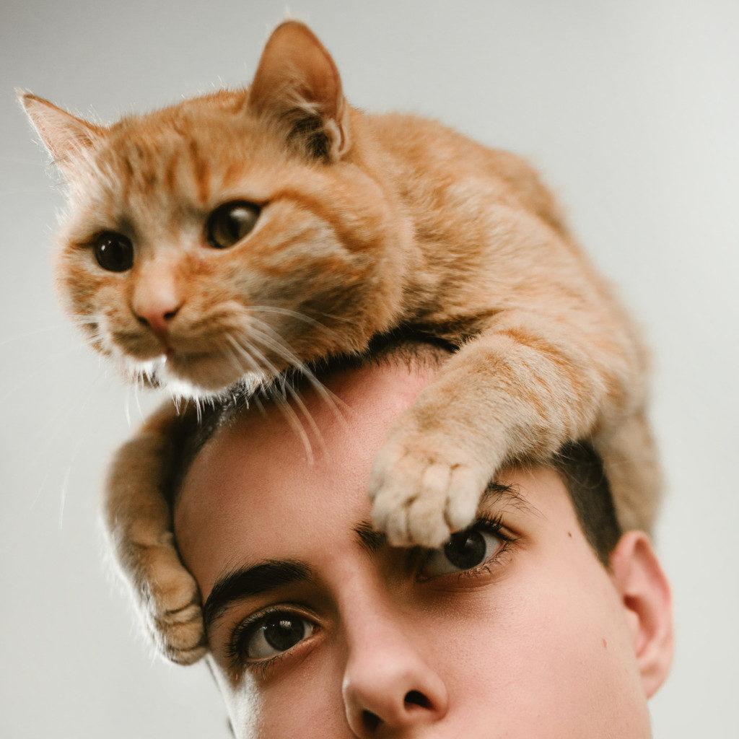
Writing the S.P.F
Introduce Character(s) (+added info)
Say what’s happening before the problem
- Who (character)
- What
- Where
- When
Sentence(s) saying what’s happening just before the start of the problem
Sentence(s) that State Problem
Sentence(s) that names/describe feeling
Tim = rescue cat
At the RSPCA adoption centre Crowded and cold cage, lots of strange humans
Tim wants his forever home. Other cats keep being adopted not TIm.
stressed + doubtful about his new owner
Notes:
Sentence(s) saying what’s happening just before the start of the problem
Sentence(s) that State Problem
Teacher to model writing SPF
Start with problem
Character = _____ seeking refuge
Setting = left city, packed up things and set sail on a boat
Problem = Lost at sea
Feeling = scared, doubtful

Slide 27
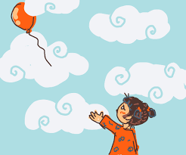
Your task today
Introduce Character(s) (+added info)
Say what’s happening before the problem
- Who (character)
- What
- Where
- When
Sentence(s) saying what’s happening just before the start of the problem
Sentence(s) that State Problem
Sentence(s) that names/describe feeling
Using the prompt, plan the beginning of your narrative. Following the guided format, write the beginning of the narrative.

Slide 28
Reflection
Author's Chair: student to share the beginning of their narrative with the character and feeling.

Slide 29
Writing
Session 2 Week 10
Write the plan, attempt, consequence and feeling (PL.A.C.E).

Slide 30
Activating Prior Knowledge
Who is in the story (people, animals)​
Context – where, when and why the story is taking place.
The main challenge the characters have to overcome​
How the character feeling about the problem.​
What the character planned or decided to do.​
The plan put into action.​
The result of the plan
What is the conclusion? How does the story end?​
How the character feels at the end of the story. ​

Slide 31
Learning Intentions
Our learning goal is to:
write the plan, attempt, consequence and feeling (PL.A.C.E).

Slide 32
What is PL.A.C.E? (Plan, Attempt, Consequence, Emotional Response)
The S.P.F in a story is usually followed by PL.A.C.E (Plan, Attempt, Consequence and Emotional Response). These elements need to all be related to one another and the problem of the story.
The attempt must match the plan, and the consequence is a result of the attempt.
CFU Question: What is included in PL.A.C.E?
In PL.A.C.E, we include...
Problem
Plan
Attempt
Consequence
Emotional Response
Wolf needed sugar
Get some from the neighbours
Knocked on the first pig's house
Ignored
Curious
Example:

Slide 33
Writing the PL.A.C.E
Sentence(s) saying what character(s) think of doing.
Sentence(s) telling what characters did from plan
Sentence(s) telling what happened because of the attempt
Sentence (s) saying how the consequence makes the character(s) feel
As he ran across the road, the top flavour of his ice-cream toppled onto the road. In his desperation to catch it, he dropped the entire cone!
He looked in horror as his ice-cream slowly began to melt on the burning bitumen.
Instinct to pick up
Horn + car comes
Crushed icecream disappointed
Notes:
Teacher to model Note-taking
Plan – instinct to pick it up -
Attempt – takes a step but hears car horn and moves out of the way.
Consequence – car runs over the ice-cream
Feeling – disappointed, stunned = kicks stone all the way home.
Teacher to model:
His first instinct was to scoop up the ice-cream and save what he could. As he bent down, he heard a loud sharp horn, warning him to move out of the way. Brendan jolted back off the road and watched the wheels of the car crush his ice-cream. Feeling stunned and disappointed, he started the slow and hungry journey home as the scorching sun beat down on him.
Teacher to type up so students can see whole beginning of narrative.

Slide 34
Writing the PL.A.C.E
Sentence(s) saying what character(s) think of doing.
Sentence(s) telling what characters did from plan
Sentence(s) telling what happened because of the attempt
Sentence (s) saying how the consequence makes the character(s) feel
Whilst handing out the bananas to feed the monkeys, she notices there is one banana left in the bucket. She turns back to realise that the gate never clicked shut, which can only mean one thing.
A sea of shock and panic washed over her as she realised the monkey had escaped.
Notes:
Teacher to model Note-taking
Teacher to model:

Slide 35
Your task today
Sentence(s) saying what character(s) think of doing.
Sentence(s) telling what characters did from plan
Sentence(s) telling what happened because of the attempt
Sentence (s) saying how the consequence makes the character(s) feel
Using the prompt, plan and write the PL.A.C.E of your narrative following the guided format.

Slide 36
Reflection
With another group, share your plan, attempt, consequence and feeling.

Slide 37
Writing
Session 3 Week 10

Slide 38
Activating Prior Knowledge
Who is in the story (people, animals)​
Context – where, when and why the story is taking place.
The main challenge the characters have to overcome​
How the character is feeling about the problem.​
What the character planned or decided to do.​
The plan put into action.​
The result of the plan
What is the conclusion? How does the story end?​
How the character feels at the end of the story. ​

Slide 39
Learning Intentions
Our learning goal is to:
write an ending.

Slide 40
What is the ending? (Ending + End Feeling)
An ending is the conclusion to the story. It completes the story so the reader feels satisfied.
An ending should include:
Sentence(s) that tell what happened after the consequence.
Sentence(s) that tell what the character(s) feel or think at the end of the story.
- it could also include a moral or a learned lesson
CFU Question: What is included in an ending?
An ending includes..
Example | Non-example
Lisa placed runner on his lead and walked him home, with a sigh of relief. One thing was for sure- Lisa would never take Runner on a walk again! | Then I woke up... To be continued...

Slide 41
Writing the ending
Sentence(s) that tell what happened after the consequence.
Sentence(s) that tell what the character(s) feel or think at the end of the story.
takes a step but hears car horn and moves out of the way.
car runs over the ice-cream disappointed, stunned = kicks stone all the way home.
Notes:
Sentence(s) that tell what happened after the consequence.
Consequence can have 'emotional response'-feeling.
Sentence(s) that tell what the character(s) feel or think at the end of the story.
Teacher to model note taking and turning notes into sentences.
Ending = Following Friday gets ice-cream & carefully crosses the road home
End feel = satisfied but now always cautious
Brendan had to wait until the following Friday to get another ice-cream and on this occasion he was extra careful when crossing the road. As he reached the other side, he relished his sweet treat, knowing he had not made the same mistake as last week. From then on, Brendan was always cautious when crossing, especially when holding an ice-cream

Slide 42
Your task today
Sentence(s) that tell what happened after the consequence.
Sentence(s) that tell what the character(s) feel or think at the end of the story.
Adding onto your narrative from this week, plan and write your ending.

Slide 43
Reflection
Today we learned about the ending in a narrative.
The ending includes:
Sentence(s) that tell what happened after the consequence.
Sentence(s) that tell what the character(s) feel or think at the end of the story.
The ending should leave the reader feeling satisfied.

Slide 44
Writing
Session 4 Week 10

Slide 45
Learning Intentions
Our learning goal is to:
Publish my narrative on the computer.

