Slide 1
Writing session 1

Slide 2
Learning Goal and Success Criteria
Learning Goal:
Our learning goal is to…
Identify run on sentences.
Success Criteria:
I will be successful if …
I can identify run on sentences and complete sentences.

Slide 3
What is a clause?
CFU: Which of the following is a clause? How do you know?
A) a bird
B) fell asleep
C) lola feels happy
_______ is a clause because….
Clauses contain a subject and a predicate.
the dog ran away
This is a clause because it contains a subject (the dog) and a predicate (ran away).
the dog ran away
Notes:
Clauses contain a subject and a predicate.
Sentences can contain one or more clauses and have boundary punctuation.

Slide 4
What is a sentence?
Sentences can contain one or more clauses and have boundary punctuation.
I jumped in the pool.
This is a sentence with one clause. It has one subject and one predicate.
I jumped in the pool because I felt hot.
This is a sentence with two clauses. It has two subjects and two predicates, joined by a conjunction.
CFU: How many clauses are in the following sentence? How do you know?
Lots of people like to eat chocolate but it shouldn’t be eaten all the time.
There is/are __ clause/s in this sentence because…
I jumped in the pool.
I jumped in the pool because I felt hot
Notes:
Clauses contain a subject and a predicate.
Sentences can contain one or more clauses and have boundary punctuation.

Slide 5
Listen and track while I read this sentence:
Sally ran towards the jungle she found a lake and rested.
This sentence contains two clauses that have not been joined together properly.
In writing, we call this a run-on sentence.
Sally ran towards the jungle she found a lake and rested.
Notes:
Teacher to read the following as punctuated:
Sally ran towards the jungle she found a lake and rested.
At night, the boy had a nightmare, he woke up.

Slide 6
What is a run-on sentence?
Definition: A run-on sentence is two or more clauses that are joined incorrectly in one sentence.
How can clauses be joined incorrectly?
1. Not separated by a full stop
2. Not separated by a conjunction (and, because, but, so…)
CFU: Define a run-on sentence in your own words.
A run-on sentence is…..
Notes:
Read chorally

Slide 7
Identifying a run-on sentence.
STEPS:
Step 1: read the sentence aloud.
Step 2: find the subject and predicate; look for any additional subjects and predicates.
Step 3: if there is another subject and predicate, check if there is a conjunction linking the sentences.
A flag design competition was held in 1901.
CFU: Identify whether the following is a run-on sentence or a complete sentence.
The Australian flag is flown on special days of national commemoration.
This is a ________ sentence because…..
Notes:
Teacher to model the following, using the steps.
A flag design competition was held in 1901.
Find the subject and predicate:
A flag design competition (sub)
Was held in 1901 (pred)
Highlight sub in red, and pred in blue.
There are no other subs and predicates, so this is a complete sentence.
You do:
The Australian flag is flown on special days of national commemoration.
Students to follow the steps then answer the CFU question in turn and talk.

Slide 8
Identifying a run-on sentence.
STEPS:
Step 1: read the sentence aloud.
Step 2: find the subject and predicate; look for any additional subjects and predicates.
Step 3: if there is another subject and predicate, check if there is a conjunction linking the sentences.
The Australian Flag was designed in 1901 it was officially recognised in 1953.
CFU: Identify whether the following is a run-on sentence or a complete sentence.
The Australian flag should never be allowed to lie on the ground it should never fall either.
This is a ________ sentence because…..
Notes:
Teacher to model the following, using the steps.
The Australian Flag was designed in 1901 it was officially recognised in 1953.
Find the subject and predicate:
The Aus Flag (sub)
Was designed in 1901 (pred)
Highlight sub in red, and pred in blue.
It (sub)
Was officially….(pred)
So this sentence has two clauses – Step 3: are they joined by a conjunction? No, so this is a run-on sentence.
You do:
The Australian flag should never be allowed to lie on the ground it should never fall either.
Students to follow the steps then answer the CFU question in turn and talk.

Slide 9
Identifying a run-on sentence.
STEPS:
Step 1: read the sentence aloud.
Step 2: find the subject and predicate; look for any additional subjects and predicates.
Step 3: if there is another subject and predicate, check if there is a conjunction linking the sentences.
The Commonwealth Star was changed so it represents the territories as well.
so
CFU: Identify whether the following is a run-on sentence or a complete sentence.
Australians have the Union Jack on their flag because they are part of the Commonwealth.
This is a ________ sentence because…..
Notes:
Teacher to model the following, using the steps.
The Commonwealth Star was changed so it represents the territories as well.
Find the subject and predicate:
The Com Star (sub)
Was changed… (pred)
Highlight sub in red, and pred in blue.
It (sub)
Can represent…. (pred)
So this sentence has two clauses – Step 3: are they joined by a conjunction? Yes, by the conjunction so (highlight pink).
This is a complete sentence.
You do:
Australians have the Union Jack on their flag because they are part of the Commonwealth.
Students to follow the steps then answer the CFU question in turn and talk.

Slide 10
Your task:
Identify the following sentences on your page as either a run-on sentence or a complete sentence.
STEPS:
Step 1: read the sentence aloud.
Step 2: find the subject and predicate; look for any additional subjects and predicates.
Step 3: if there is another subject and predicate, check if there is a conjunction linking the sentences.

Slide 11
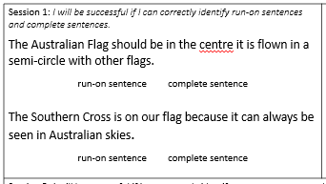
Check in – Exit Ticket Learning Task
Complete the ‘Session 1’ part of the exit ticket.
This is your chance to show your parents what you have learned about run-on sentences.

Slide 12
Writing

Slide 13
Learning Goal and Success Criteria
Learning Goal:
Our learning goal is to…
Identify run on sentences.
Success Criteria:
I will be successful if …
I can identify run on sentences and complete sentences.

Slide 14
What is an object?
The dog
The dog ran through the gate.
Subject: The noun (person place or thing) that is performing the verb.
Object: An object is the person, place, or thing that receives the action (the object is part of the predicate).
Notes:
Read definitions as a class.

Slide 15
What is a sentence?
Subject: The noun (person place or thing) that is performing the verb.
Object: An object is the person, place, or thing that receives the action (the object is part of the predicate).
A man paints posters.
CFU: What is the subject in this sentence? What is the object in this sentence?
Marilyn forgot her keys and phone.
The subject is _______. The object is _______.
A man
Notes:
Teacher to do
A man paints posters.
The subject is ‘A man’
The predicate is ‘paints posters’ so the object is ‘posters’.
CFU:
You do:
Marilyn forgot her keys and phone.
Subject: Marilyn
Predicate: forgot her keys and phone.
Object: keys and phone.

Slide 16
What is a run-on sentence?
Definition: A run-on sentence is two or more clauses that are joined incorrectly in one sentence.
How can clauses be joined incorrectly?
1. Not separated by a full stop
2. Not separated by a conjunction (and, because, but, so…)
CFU: Define a run-on sentence in your own words.
A run-on sentence is…..
Notes:
Read chorally

Slide 17
Identifying a run-on sentence.
STEPS:
Step 1: read the sentence aloud.
Step 2: find the subject and predicate; look for any additional subjects and predicates.
Step 3: if there is another subject and predicate, check if there is a conjunction linking the sentences.
Step 4: Highlight the ‘and’s to check they are not being over-used.
It became the official flag for the Aboriginal Tent Embassy in Canberra and it was first flown there in 1972 and it has become a widely recognised symbol.
and
and
CFU: Identify whether the following is a run-on sentence or a complete sentence.
The Aboriginal flag is divided horizontally into halves and the top half is black and the lower half red and there is a yellow circle in the centre of the flag.
This is a ________ sentence because…..
Notes:
I do:
It became the official flag for the Aboriginal Tent Embassy in Canberra and it was first flown there in 1972 and it has become a widely recognised symbol.
Go through the steps
Highlight the 2 ands – this sentence has too many clauses joined by ands.
It is a run-on sentence.
We do:
The Aboriginal flag is divided horizontally into halves and the top half is black and the lower half red and there is a yellow circle in the centre of the flag.
Go through the steps
Highlight the 3 ands – this sentence has too many clauses joined by ands.
It is a run-on sentence.

Slide 18
Identifying a run-on sentence.
STEPS:
Step 1: read the sentence aloud.
Step 2: find the subject and predicate; look for any additional subjects and predicates.
Step 3: if there is another subject and predicate, check if there is a conjunction linking the sentences.
Step 4: Highlight the ‘and’s to check they are not being over-used.
The Commonwealth took steps to give the flag legal recognition, the Aboriginal flag was declared a ‘Flag of Australia’ under the Flags Act 1953.
CFU: Identify whether the following is a run-on sentence or a complete sentence.
Many people continued to fly the Union Jack, the new flag was officially recognised as the Australian national flag in 1953.
This is a ________ sentence because…..
Notes:
I do:
The Commonwealth took steps to give the flag legal recognition, the Aboriginal flag was declared a ‘Flag of Australia’ under the Flags Act 1953.
Go through the steps
Highlight the two subjects and predicates- this sentence has too many clauses joined by a comma.
It is a run-on sentence.
We do:
Many people continued to fly the Union Jack, the new flag was officially recognised as the Australian national flag in 1953.
Go through the steps
Highlight the two subjects and predicates- this sentence has too many clauses joined by a comma.
It is a run-on sentence.

Slide 19
Your task:
Identify the following sentences on your page as either a run-on sentence or a complete sentence.
STEPS:
Step 1: read the sentence aloud.
Step 2: find the subject and predicate; look for any additional subjects and predicates.
Step 3: if there is another subject and predicate, check if there is a conjunction linking the sentences.
Step 4: Highlight the ‘and’s to check they are not being over-used.

Slide 20
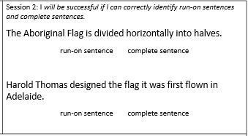
Check in – Exit Ticket Learning Task
Complete the ‘Session 2’ part of the exit ticket.
This is your chance to show your parents what you have learned about run-on sentences.

Slide 21
Writing session 2

Slide 22
Learning Goal and Success Criteria
Learning Goal:
Our learning goal is to…
Correct a run-on sentence.
Success Criteria:
I will be successful if …
I can correct a run-on sentence by adding punctuation or a subordinating conjunction.

Slide 23
Subordinating conjunctions
A subordinating conjunction is the word that is used to join a subordinating clause to another clause or sentence.
Because – reason
But – change in direction
However – change in direction
So – cause and effect
CFU: Which subordinating conjunction fits to join the following clauses:
Mandy fell over _______________ she needed a band-aid.
Mandy fell over _______________ her shoelaces were untied.
Mandy fell over _______________ she got up and kept running.
Notes:
Subordinating Conjunctions
Because – reason
But – change in direction
However – change in direction
So – cause and effect
Which s/c fits the following:
Mandy fell over _____ she needed a band-aid.
Mandy fell over _____ her shoelaces were untied.
Mandy fell over _____ she got up and kept running.

Slide 24
What is a run-on sentence?
Definition: A run-on sentence is two or more clauses that are joined incorrectly in one sentence.
How can clauses be joined incorrectly?
1. Not separated by a full stop
2. Not separated by a conjunction (and, because, but, so…)
CFU: Define a run-on sentence in your own words.
A run-on sentence is…..
Notes:
Read chorally

Slide 25
How to correct a run-on sentence.
Step 1: Read the sentence aloud.
Step 2: identify if it is a run-on sentence
Step 3a: add punctuation or a conjunction to make it a complete sentence. OR
Step 3b: Separate the clauses into more than one sentence.
The Torres Strait Islander flag has three horizontal panels, these panels are divided by thin black lines.
Notes:
I do: (Adding a full stop).
The Torres Strait Islander flag has three horizontal panels, these panels are divided by thin black lines.
Is this a run on sentence? Yes because the clauses are joined by a comma.
I could add a full stop to this sentence to make it 2 complete sentences.
Re-write: The Torres Strait Islander flag has three horizontal panels. These panels are divided by thin black lines.

Slide 26
How to correct a run-on sentence.
Step 1: Read the sentence aloud.
Step 2: identify if it is a run-on sentence
Step 3a: add punctuation or a conjunction to make it a complete sentence. OR
Step 3b: Separate the clauses into more than one sentence.
The star is also a symbol for seafaring people, it is used in navigation.
Notes:
You do:
The star is also a symbol for seafaring people, it is used in navigation.
Is this a run on sentence? Yes because it is joined by a comma and not a full stop.
I could add a full stop to this sentence.
Re-write: The star is also a symbol for seafaring people. It is used in navigation.

Slide 27
How to correct a run-on sentence.
Step 1: Read the sentence aloud.
Step 2: identify if it is a run-on sentence
Step 3a: add punctuation or a conjunction to make it a complete sentence. OR
Step 3b: Separate the clauses into more than one sentence.
The five-pointed star is on the Torres Strait Islander flag it represents the five island groups within the Torres Strait.
Notes:
I do: (Adding a S/C)
The five-pointed star is on the Torres Strait Islander flag it represents the five island groups within the Torres Strait.
Is this a run on sentence? Yes because it has two subjects and two predicates (clauses) without a full stop or a subordinating conjunction.
I could add a full stop to this sentence; however, the second sentence is a reason why it is on the flag so I can use ‘because’.
Re-write: The five-pointed star is on the Torres Strait Islander flag because it represents the five island groups within the Torres Strait.

Slide 28
How to correct a run-on sentence.
Step 1: Read the sentence aloud.
Step 2: identify if it is a run-on sentence
Step 3a: add punctuation or a conjunction to make it a complete sentence. OR
Step 3b: Separate the clauses into more than one sentence.
The Torres Strait Islander flag was designed in 1992 it was not recognised until 1995.
Notes:
You do:
The Torres Strait Islander flag was designed in 1992 it was not recognised until 1995.
Is this a run on sentence? Yes because has two subjects and two predicates without a full stop or a subordinating conjunction.
I could add a full stop to this sentence; however, the second sentence is a change in direction, so I can use ‘but’ or ‘however,’
Re-write: The Torres Strait Islander flag was designed in 1992, but it was not recognised until 1995.

Slide 29
Your task:
Correct the following run-on sentences by adding punctuation or a subordinating conjunction:
The Torres Strait Islander Flag was designed by Bernard Namok, it was the winning design in a competition.
The Torres Strait Islander Flag is an official Flag of Australia the Australian Government recognised it.

Slide 30
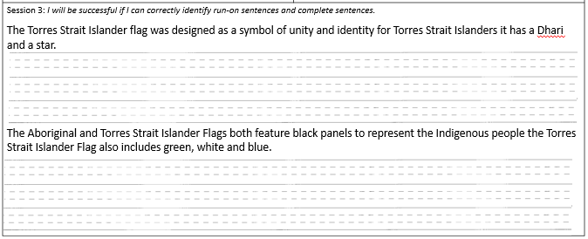
Check in – Exit Ticket Learning Task
Complete the ‘Session 3’ part of the exit ticket.
This is your chance to show your parents what you have learned about run-on sentences.

Slide 31
Writing

Slide 32
Notes:
Narrative Prompt: students to brainstorm as many ideas as they can in 5 minutes.

Slide 33
Learning Goal and Success Criteria
Learning Goal:
Our learning goal is to…
Identify run on sentences.
Success Criteria:
I will be successful if …
I can identify run on sentences and complete sentences.

Slide 34
Activating Prior Knowledge
I went shopping and bought apples, peaches and bananas.
Notes:
APK:
What is the name of the punctuation mark that is in red? We have a name for this, this is called a comma.
Where else have you seen it?
When is it used?

Slide 35
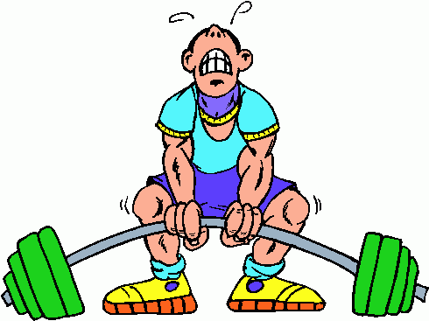
What is a comma?
CFU: True or false.
Can a comma join two sentences together? Why/Why not?
A comma ____ join two sentences together because...
A comma is a punctuation mark used to separate parts of a sentence.
Commas are not strong enough to join sentences together.
Notes:
Choral read.

Slide 36
What is a run-on sentence?
Definition: A run-on sentence is two or more clauses that are joined incorrectly in one sentence.
How can clauses be joined incorrectly?
1. Not separated by a full stop
2. Not separated by a conjunction (and, because, but, so…)
3. Separated incorrectly by a comma.
4. Separated by too many 'and's.
CFU: Define a run-on sentence in your own words.
A run-on sentence is…..
Notes:
Read chorally

Slide 37
Identifying a run-on sentence.
STEPS:
Step 1: read the sentence aloud.
Step 2: find the subject and predicate; look for any additional subjects and predicates.
Step 3: if there is another subject and predicate, check if there is a conjunction linking the sentences.
Step 4: Highlight the ‘and’s to check they are not being over-used.
Australia is the sixth-largest country in the world.
CFU: Identify whether the following is a run-on sentence or a complete sentence.
Australia is made up of six states and two territories.
This is a ________ sentence because…..
Notes:
Teacher to model the following, using the steps.
Australia is the sixth-largest country in the world.
Find the subject and predicate:
Australia... (sub)
is... (pred)
Highlight sub in red, and pred in blue.
There are no other subs and predicates, so this is a complete sentence.
You do:
Australia is made up of six states and two territories.
Australia (sub)
Is.... predicate.
Students to follow the steps then answer the CFU question in turn and talk.

Slide 38
Identifying a run-on sentence.
STEPS:
Step 1: read the sentence aloud.
Step 2: find the subject and predicate; look for any additional subjects and predicates.
Step 3: if there is another subject and predicate, check if there is a conjunction linking the sentences. Step 4: Highlight the ‘and’s to check they are not being over-used.
Australia has settlements a settlement is a place where people live.
CFU: Identify whether the following is a run-on sentence or a complete sentence.
Capital cities are the biggest cities in the state governments are usually based there.
This is a ________ sentence because…..
Notes:
Teacher to model the following, using the steps.
Australia has settlements a settlement is a place where people live.
Find the subject and predicate:
Australia (sub)
Has... (pred)
Highlight sub in red, and pred in blue.
A settlement (sub)
Is a ....(pred)
So this sentence has two clauses – Step 3: are they joined by a conjunction? No, so this is a run-on sentence.
You do:
Capital cities are the biggest cities in the state governments are usually based there.
Capital cities (sub)
Are the... (pred)
Governments (sub)
Are usually... (pred)
Students to follow the steps then answer the CFU question in turn and talk.

Slide 39
Identifying a run-on sentence.
STEPS:
Step 1: read the sentence aloud.
Step 2: find the subject and predicate; look for any additional subjects and predicates.
Step 3: if there is another subject and predicate, check if there is a conjunction linking the sentences.
All states and territories have regional centres, they have large populations.
CFU: Identify whether the following is a run-on sentence or a complete sentence.
Brisbane is the capital city of Queensland, it provides major services for the people that live there.
This is a ________ sentence because…..
Notes:
Teacher to model the following, using the steps.
All states and territories have regional centres, they have large populations.
Find the subject and predicate:
All states and territories (sub)
Have regional… (pred)
Highlight sub in red, and pred in blue.
they (sub)
Have large.... (pred)
So this sentence has two clauses – Step 3: are they joined by a conjunction? No.
They are joined by a comma. Are comma's strong enough to join two sentences? No so it is a run-on sentence.
You do:
Brisbane (sub)
Is the... (pred)
It (sub)
Provides.. (predi
So this sentence has two clauses – Step 3: are they joined by a conjunction? No.
They are joined by a comma. Are comma's strong enough to join two sentences? No so it is a run-on sentence.

Slide 40
Your task:
Identify the following sentences on your page as either a run-on sentence or a complete sentence.
STEPS:
Step 1: read the sentence aloud.
Step 2: find the subject and predicate; look for any additional subjects and predicates.
Step 3: if there is another subject and predicate, check if there is a conjunction linking the sentences.
Notes:
Australia is the sixth largest country in the world. (c/s)
Some settlements are very big, some settlements are very small. (r/o)
Geelong is a regional centre in Victoria, it has a large population. (r/o)
Tasmania is an island, but it is still part of Australia. (c/s)
Hospitals and police stations are types of services banks are a type of service too. (r/o)

Slide 41
Check in – Summary
Today we practised identifying run-on sentences.
We learned that commas are not strong enough to join two sentences.
When a comma is joining two sentences together, we know that is a run-on sentence.

Slide 42
Writing

Slide 43
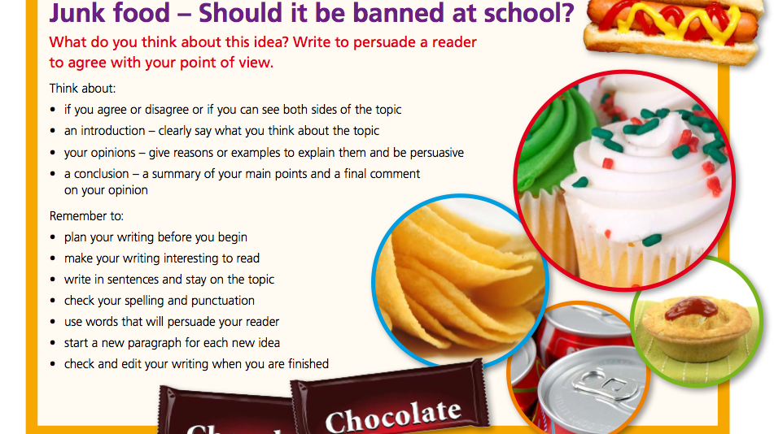
Notes:
Persuasive brainstorming prompt.
Students to pick a side and brainstorm as many reasons as they can in 5 minutes.

Slide 44
Learning Goal and Success Criteria
Learning Goal:
Our learning goal is to…
correct run-on sentences.
Success Criteria:
I will be successful if …
I can correct run-on sentences by adding punctuation or a conjunction.

Slide 45
What is a comma?
A comma is a punctuation mark used to separate parts of a sentence.
Commas are not strong enough to join sentences together.
CFU: True or false.
Has the comma been used incorrectly in the following sentence:
Australia is the sixth- largest country in the world, it is made up of states and territories.
The comma has been used _____ because...
Notes:
APK:
Recap over what a comma is, remind students that a comma is not strong enough to join two sentences together.

Slide 46
What is a run-on sentence?
Definition: A run-on sentence is two or more clauses that are joined incorrectly in one sentence.
How can clauses be joined incorrectly?
1. Not separated by a full stop
2. Not separated by a conjunction (and, because, but, so…)
3. Separated incorrectly by a comma.
4. Separated by too many 'and's.
CFU: How are clauses joined incorrectly?
Clauses are joined incorrectly when…..
Notes:
Read chorally

Slide 47
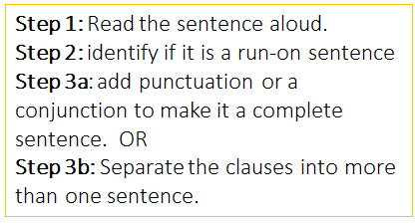
Correct a run-on sentence.
Victoria is the smallest mainland state, it has the second highest population.
Notes:
I do: (Adding a full stop).
Victoria is the smallest mainland state, it has the second highest population.
Is this a run on sentence? Yes because the clauses are joined by a comma.
I could add a full stop to this sentence to make it 2 complete sentences.
Re-write: Victoria is the smallest mainland state. It has the second highest population.

Slide 48
Correct a run-on sentence.
The Twelve Apostles are a popular tourist attraction, they are huge rock formations.
Notes:
You do: (Adding a full stop).
The Twelve Apostles are a popular tourist attraction, they are huge rock formations.
Is this a run on sentence? Yes because the clauses are joined by a comma.
I could add a full stop to this sentence to make it 2 complete sentences.
Re-write: The Twelve Apostles are a popular tourist attraction. They are huge rock formations.

Slide 49
Correct a run-on sentence.
The MCG is a historic landmark, the Olympics were held there in 1956.
Notes:
I do: (Adding a conjunction)
The MCG is a historic landmark, the Olympics were held there in 1956.
Is this a run on sentence? Yes because the clauses are joined by a comma.
I could add a full stop to this sentence to make it 2 complete sentences. Or I can add a conjunction. The Olympics were held there in 1956 gives us a reason why the MCG is historic. We can use the conjunction because.
Re-write: The MCG is a historic landmark because the Olympics were held there in 1956.

Slide 50
Correct a run-on sentence.
The 12 Apostles are huge rock formations in Victoria, eight of them remain standing.
Notes:
You do: (Adding a conjunction)
The 12 Apostles are a huge rock formations in Victoria, eight of them remain standing.
Is this a run on sentence? Yes because the clauses are joined by a comma.
I could add a full stop to this sentence to make it 2 complete sentences. Or I can add a conjunction. The 12 Apostles are a huge rock formations in Victoria has a change in direction.
Re-write: The 12 Apostles are a huge rock formations in Victoria; however, eight of them remain standing.

Slide 51
Your task:
Correct the following run-on sentences by adding punctuation or a subordinating conjunction:
1. People go to Sovereign Hill to experience life in the 1850s, they pan for gold using gold pans.
2. The Eureka Tower is the second tallest building in Australia, it has amazing views of Melbourne and Port Philip Bay.
3. Melbourne is the capital city of Victoria, it is one of Australia's largest cities.
Notes:
1) Full stop
2) So
3) Full stop

Slide 52
Check in – Relevance
Why are we learning to correct run-on sentences? Which reason is the most motivating to you?
A) I will be able to edit my writing properly.
B) I will understand what makes a complete sentence.
C) I will become a better writer.
D) I will understand how to use conjunctions correctly.
Notes:
Students to choose which reason is the most motivating to them.

