Slide 1

Story Grammar
w2L
Learn to Write
Write to Learn
Year 2, Write to Learn
Notes:
Lesson will go for 40 minutes.

Slide 2
Story Grammar
Planning
LESSON 1

Slide 3



Read and Model Steps
Use Example
Identify the Topic Sentence and Supporting Details
REVIEW
Steps:
1. Read all sentences.
2. Identify which sentence is explaining a main idea and mark it with a T.S (Topic Sentence).
3. Identify which sentence/s have/has a detail that explains or proves the main idea and mark it as a S.D (Supporting Detail).
Plastic pollution kills 100,000 marine mammals every year.
SD
Pollution is destroying our marine life.
TS
It can injure coral reefs.
SD
1-1

Slide 4


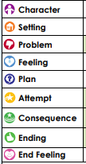
Teacher and students read together.
Ask discussion question
Briefly note examples of ways of adding detail
APK
What is Story Grammar?
Story grammar is the necessary components that a fiction text needs to have to be a narrative.
Who is in the story (people, animals)​
The location – where is it happening? ​
The main challenge the characters have to overcome​
How the character feeling about the problem.​
What the character planned or decided to do.​
The plan put into action.​
The result of the problem being solved​
What is the conclusion? How does the story end?​
How the character feels at the end of the story. ​
1-2

Slide 5

I will plan my narrative using the story grammar template.
Teacher and students read together.
TODAY’S LEARNING GOAL
1-3

Slide 6



Teacher Models Left Example,
Students Complete Right Example
Read and Model Steps
Use Example
Ask question
SKILL DEVELOPMENT
Story Grammar: S.P.F (Setting, Problem, Feeling)
What can be included in a setting?
A good way to start a narrative is by introducing the setting, problem and feeling. These can be introduced in any order.
The setting could include:
- characters
- place
- time
- what's happening
The setting gives the reader information that they need so the rest of the story can be fully understood.
A setting can include...
A setting can include character, place, time and what is happening. It gives the reader information they need so the story can be fully understood.
Example​ | Non-example​
Sam trudged through the mud on his way to visit his grandma. ​ | He was sad.​
1-4

Slide 7
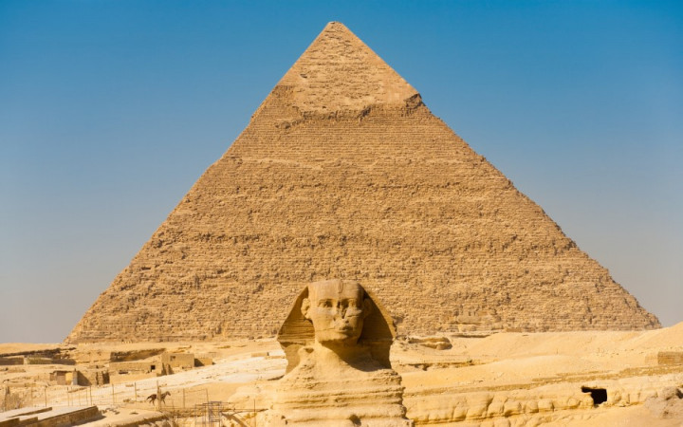
Teacher and students read together.
Ask discussion question
Briefly note examples of ways of adding detail
SKILL DEVELOPMENT
Planning the Problem
Problem
Today we are going to plan a narrative using the picture prompt below:
Turn and Talk:
What could the problem be?
What is happening just before the problem?
1-5

Slide 8
Teacher Models Left Example,
Students Complete Right Example
Model Left
Read example
Students complete
GUIDED PRACTICE
Plan the Problem
4. Character(s):
3. Setting:
Lost from tour group 1. Problem: door slams, trapped in tomb in pyramid, hearing rattling of sarcophagus
2. Feeling:
Problem: State Problem
1-6
Notes:
.

Slide 9
Teacher and students read together.
Ask discussion question
Briefly note examples of ways of adding detail
SKILL DEVELOPMENT
Planning the Feeling
Feeling
How would the characters be feeling about the problem?
Problem: door slams, trapped in tomb in pyramid, hearing rattling of sarcophagus
Turn and Talk:
How did the characters feel in response to the problem?
1-5
Notes:
Terrified, little excitement

Slide 10
Teacher Models Left Example,
Students Complete Right Example
Model Left
Read example
Students complete
GUIDED PRACTICE
Plan the Feeling
4. Character(s):
3. Setting:
Lost from tour group 1. Problem: door slams, trapped in tomb in pyramid, hearing rattling of sarcophagus
2. Feeling:Terrified, little excitement
Feeling: State Feeling
1-6
Notes:
.

Slide 11
Teacher and students read together.
Ask discussion question
Briefly note examples of ways of adding detail
SKILL DEVELOPMENT
Planning the Character and Setting
Characters and Setting
Story grammar is the necessary components that a fiction text needs to have to be a narrative.
Today we are going to plan a narrative using the picture prompt below:
Turn and Talk:
Who?
What?
Where?
When?
Why?
1-5
Notes:
What: excursion
Where: Pyramids of Giza
When: scorching, hot afternoon
Why: Kids saw gold, went exploring through corridors

Slide 12
Teacher Models Left Example,
Students Complete Right Example
Model Left
Read example
Students complete
GUIDED PRACTICE
Plan the Characters and Setting
4. Character(s): Two kids- adventurous, curious, risk-takers, naughty/cheeky, Year 2 tour guide, fellow students and teacher
3. Setting: One scorching hot afternoon at the Pyramids of Giza.
Lost from tour group 1. Problem: door slams, trapped in tomb in pyramid, hearing rattling of sarcophagus
2. Feeling: Terrified, little excitement
Characters State character and setting.
1-6
Notes:
.

Slide 13

GUIDED PRACTICE
Check Your Plan
Stop and check your plan makes sense.
4. Character(s): Two kids- adventurous, curious, risk-takers, naughty/cheeky, Year 2 tour guide, fellow students and teacher
3. Setting: One scorching hot afternoon at the Pyramids of Giza
Lost from tour group 1. Problem: door slams, trapped in tomb in pyramid, hearing rattling of sarcophagus
2. Feeling: Terrified, little excitement
STEPS
1. Re-read your plan and check.
2. Your story has character(s), setting, problem and character feeling.
3. You have enough detail in each section to continue planning your narrative.
1-10

Slide 14
Teacher and students read together.
Ask discussion question
Briefly note examples of ways of adding detail
SKILL DEVELOPMENT
Planning the Attempt
Attempt
What will the characters do to fix the problem?
Turn and Talk:
What are they going to do to fix the problem?
1-5
Notes:
Attempt: the students feel the walls looking for a loose brick to find a way out of the tomb.

Slide 15
Teacher Models Left Example,
Students Complete Right Example
Model Left
Read example
Students complete
GUIDED PRACTICE
Plan the Attempt
6. Plan
5. Attempt the students feel the walls looking for a loose brick to escape out of the tomb and push as hard as they can.
7. Consequence:
8. Ending:
9. Ending Feeling
1-11
Notes:
Attempt: the students feel the walls looking for a loose brick to escape out of tomb.

Slide 16
Teacher and students read together.
Ask discussion question
Briefly note examples of ways of adding detail
SKILL DEVELOPMENT
Planning the Plan
Plan
How will the characters solve the problem?
Turn and Talk:
What would the characters think and talk about to plan their attempt?
1-5
Notes:
Plan: scream for help- no one will hear us
Push door? Too heavy
Let's search for a loose brick using hands to feel around in the dark.

Slide 17
Teacher Models Left Example,
Students Complete Right Example
Model Left
Read example
Students complete
GUIDED PRACTICE
Planning the Plan
6. Plan: Scream for help- no one will hear Push door? Too heavy Let's search for a loose brick using hands to feel around in the dark.
5. Attempt: the students feel the walls looking for a loose brick to escape out of the tomb and push as hard as they can.
7. Consequence:
8. Ending:
9. Ending Feeling
1-11

Slide 18
Teacher and students read together.
Ask discussion question
Briefly note examples of ways of adding detail
SKILL DEVELOPMENT
Planning the Consequence
Consequence
What is the result of the plan/attempt working?
Turn and Talk:
How did the attempt work?
1-5
Notes:
Consequence- squeeze/crawl through gap into the corridor.

Slide 19
Teacher Models Left Example,
Students Complete Right Example
Model Left
Read example
Students complete
GUIDED PRACTICE
Planning the Consequence
6. Plan: Scream for help- noon Push door? Too heavy Let's search for a loose brick using hands to feel around in the dark.
5. Attempt: the students feel the walls looking for a loose brick to escape out of the tomb and push as hard as they can.
7. Consequence: squeeze/crawl through gap into the corridor.
8. Ending:
9. Ending Feeling
1-11

Slide 20
Teacher and students read together.
Ask discussion question
Briefly note examples of ways of adding detail
SKILL DEVELOPMENT
Planning the Ending
Ending
How does your story end?
Turn and Talk:
What happened after the consequence?
1-5
Notes:
Ending: characters locate their tour group and sneakily re join the group

Slide 21
Teacher Models Left Example,
Students Complete Right Example
Model Left
Read example
Students complete
GUIDED PRACTICE
Planning the Ending
6. Plan: Scream for help- noon Push door? Too heavy Let's search for a loose brick using hands to feel around in the dark.
5. Attempt: the students feel the walls looking for a loose brick to escape out of the tomb and push as hard as they can.
7. Consequence: squeeze/crawl through gap into the corridor.
8. Ending: characters locate their tour group and sneakily re-join the group
9. Ending Feeling
1-11

Slide 22
Teacher and students read together.
Ask discussion question
Briefly note examples of ways of adding detail
SKILL DEVELOPMENT
Planning the End Feeling
End Feeling
How do the characters feel at the end of the story?
Turn and Talk:
How did the characters feel at the end of the story?
Clue: think about how we described them in the setting.
1-5
Notes:
End Feeling: They are relieved that they escaped from the ancient pyramid and proud that they got away

Slide 23
Teacher Models Left Example,
Students Complete Right Example
Model Left
Read example
Students complete
GUIDED PRACTICE
Planning the End Feeling
6. Plan: Scream for help- noon Push door? Too heavy Let's search for a loose brick using hands to feel around in the dark.
5. Attempt: the students feel the walls looking for a loose brick to escape out of the tomb and push as hard as they can.
7. Consequence: squeeze/crawl through gap into the corridor.
8. Ending: characters locate their tour group and sneakily re-join the group
9. Ending Feeling: End Feeling: They are relieved that they escaped from the ancient pyramid and proud that they got away
1-11

Slide 24
Stop and check your plan makes sense.
GUIDED PRACTICE
Check Your Plan
6. Plan: Scream for help- noon Push door? Too heavy Let's search for a loose brick using hands to feel around in the dark.
5. Attempt: the students feel the walls looking for a loose brick to escape out of the tomb and push as hard as they can.
7. Consequence: squeeze/crawl through gap into the corridor.
8. Ending: characters locate their tour group and sneakily re-join the group
9. Ending Feeling: They are relieved that they escaped from the ancient pyramid and proud that they got away
STEPS
1. Re-read your plan and check.
2. Your story has a plan, attempt and consequence for the problem your character(s) solve.
3. Your story has an ending and ending feeling.
1-16

Slide 25

Teacher Read Aloud
Read Passage
RELEVANCE
Why learn about Story Grammar?
It helps us write an exciting narrative
Makes it easier to plan a narrative
Makes it more interesting for the reader
1-20

Slide 26
Teacher and students read together.
Read passage and Example
Ask question
SKILL/CONCEPT CLOSURE
Today we have learnt planned a narrative using a story grammar template.
Story grammar is the necessary components that a fiction text needs to have to be a narrative
Write a character and feeling to match the following problem.
The wind blew the cubby house over and the boy was trapped inside.
Who is in the story (people, animals)​
The location – where is it happening? ​
The main challenge the characters have to overcome​
How the character feeling about the problem.​
What the character planned or decided to do.​
The plan put into action.​
The result of the problem being solved​
What is the conclusion? How does the story end?​
How the character feels at the end of the story. ​
Character: Maxwell
Feeling: scared because he was trapped under and couldn't get out.
1-21

Slide 27
Story Grammar
Converting Plan to Paragraph
LESSON 2

Slide 28
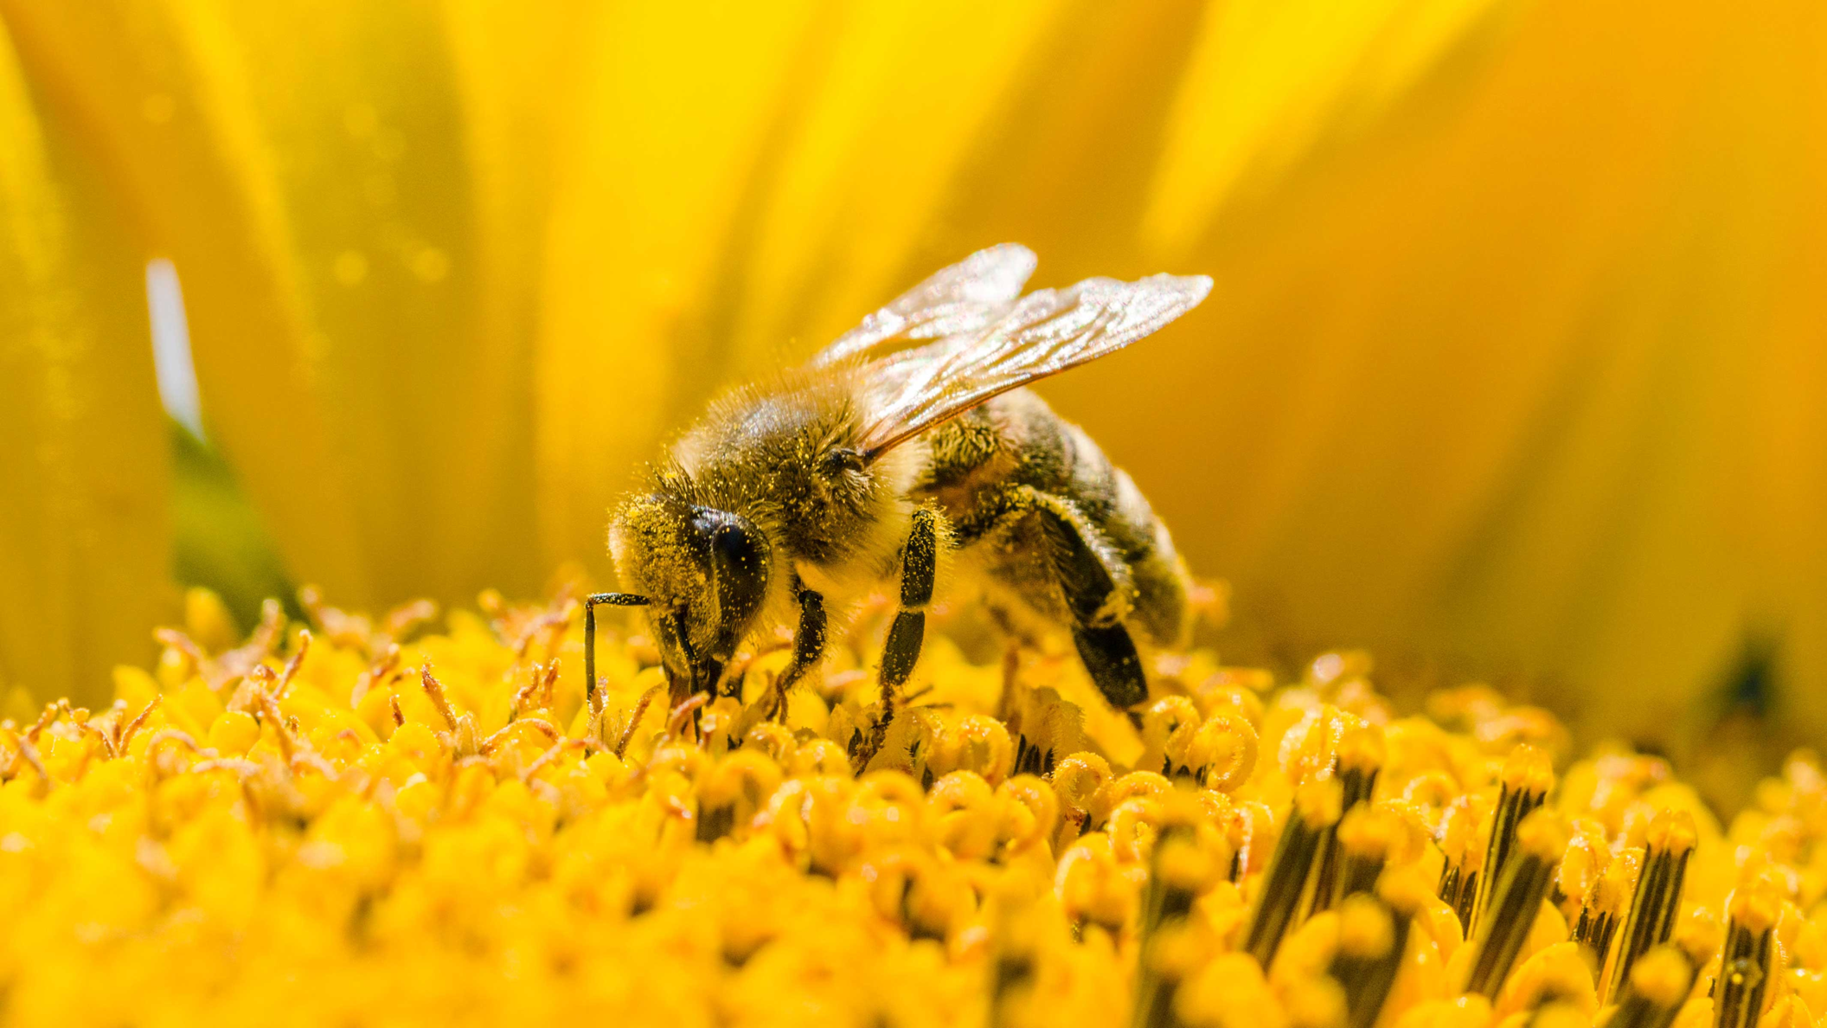
Read and Model Steps
Use Example
Identify the Topic Sentence and Supporting Details
REVIEW
Steps:
1. Read all sentences.
2. Identify which sentence is explaining a main idea and mark it with a T.S (Topic Sentence).
3. Identify which sentence/s have/has a detail that explains or proves the main idea and mark it as a S.D (Supporting Detail).
Bees have important jobs.
TS
Bees pollinate our plants.
SD
Bee's honey can be used for medicine.
SD
1-1

Slide 29
I will write the Character, Setting, Problem and Feeling paragraph.
Teacher and students read together.
TODAY’S LEARNING GOAL
2-2

Slide 30
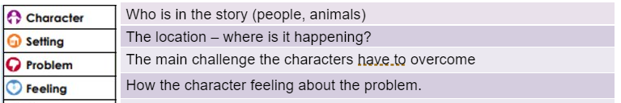
Teacher and students read together.
Ask discussion question
Briefly note examples of ways of adding detail
SKILL DEVELOPMENT
Story Grammar
What is Story Grammar?
Story grammar is the necessary components that a fiction text needs to have to be a narrative.
2-3

Slide 31

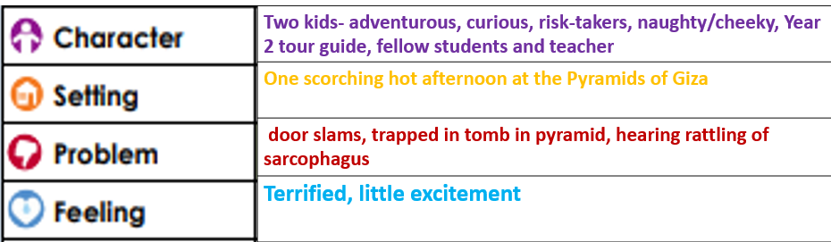
Teacher Models Left Example,
Students Complete Right Example
Read and Model Steps
Use Example
Ask question
SKILL DEVELOPMENT
Story Grammar: S.P.F (Setting, Problem, Feeling)
Creating the beginning of a narrative:
Watch the teacher use their plan to create their narrative.
3-4

Slide 32
Teacher Read Aloud
Read Passage
RELEVANCE
Why learn about Story Grammar?
It helps us write an exciting narrative
Makes it easier to plan a narrative
Makes it more interesting for the reader
2-5

Slide 33
Teacher and students read together.
Read passage and Example
Ask question
SKILL/CONCEPT CLOSURE
Write a setting to match.
Today we have learnt about identifying the components of a fiction text in relation to story grammar.
Story grammar is the necessary components that a fiction text needs to have to be a narrative
The bell rang and Amy was late to class.
Setting: School
2-6

Slide 34


Your task today
Full
Sentences
Chose which picture you would like to write about. Write your character, setting, problem and feeling paragraph. Make sure you follow your plan. You need 1-2 sentences for each section.
Capital
Letters
Punctuation
STEPS
1. Follow your plan.
2. Write a 1-2 sentences for the characters, setting, problem and feeling.
3. Re-read your paragraph and check you have included each element in your narrative.
2-7

Slide 35
Story Grammar
Converting Plan to Paragraph
LESSON 3

Slide 36
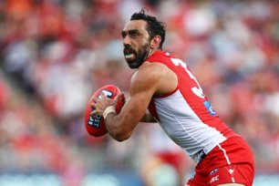
Read and Model Steps
Use Example
Identify the Topic Sentence and Supporting Details
REVIEW
SD
He is a dual Brownlow Medallist.
Adam Goodes is a professional Australian Rules football player.
He played with the Sydney Swans in the Australian Football League.
Steps:
1. Read all sentences.
2. Identify which sentence is explaining a main idea and mark it with a T.S (Topic Sentence).
3. Identify which sentence/s have/has a detail that explains or proves the main idea and mark it as a S.D (Supporting Detail).
TS
SD
1-1

Slide 37
Teacher and students read together.
Ask discussion question
Briefly note examples of ways of adding detail
APK
What is Story Grammar?
Story grammar is the necessary components that a fiction text needs to have to be a narrative.
Who is in the story (people, animals)​
The location – where is it happening? ​
The main challenge the characters have to overcome​
How the character feeling about the problem.​
What the character planned or decided to do.​
The plan put into action.​
The result of the problem being solved​
What is the conclusion? How does the story end?​
How the character feels at the end of the story. ​
3-2

Slide 38
I will write the Plan, Attempt, Consequence, Ending and End Feeling.
Teacher and students read together.
TODAY’S LEARNING GOAL
3-3

Slide 39
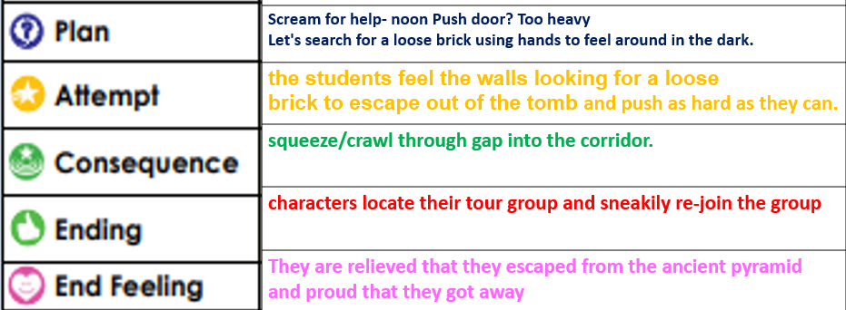
Teacher Models Left Example,
Students Complete Right Example
Read and Model Steps
Use Example
Ask question
SKILL DEVELOPMENT
Story Grammar: S.P.F (Setting, Problem, Feeling)
Creating the middle and ending of a narrative:
Watch the teacher use their plan to finish their narrative.
3-4

Slide 40
Teacher Read Aloud
Read Passage
RELEVANCE
Why learn about Story Grammar?
It helps us write an exciting narrative
Makes it easier to plan a narrative
Makes it more interesting for the reader
3-5

Slide 41
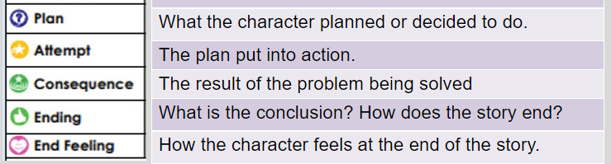
Teacher and students read together.
Read passage and Example
Ask question
SKILL/CONCEPT CLOSURE
In story grammar, what does the 'end feeling' element explain?
Today we have learnt about identifying the components of a fiction text in relation to story grammar.
Story grammar is the necessary components that a fiction text needs to have to be a narrative
The end feeling tells the reader ______
The end feeling tells the reader how the character(s) feel about the problem being solved and what they have learnt from their experience.
3-6

Slide 42
Your task today
Full
Sentences
Write your plan, attempt, consequence, ending and end feeling. Make sure you follow your plan. You need 1-2 sentences for each section.
Capital
Letters
Punctuation
STEPS
1. Follow your plan.
2. Write a 1-2 sentences for the plan, attempt, consequence, ending and end feeling.
3. Re-read your paragraph and check you have included each element in your narrative.
3-8

Slide 43
Editing and Revising
LESSON 4

Slide 44
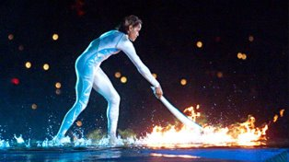
Read and Model Steps
Use Example
Identify the Topic Sentence and Supporting Details
REVIEW
Steps:
1. Read all sentences.
2. Identify which sentence is explaining a main idea and mark it with a T.S (Topic Sentence).
3. Identify which sentence/s have/has a detail that explains or proves the main idea and mark it as a S.D (Supporting Detail).
Won the women’s 400 metres.
SD
Honour of lighting the Olympic flame in the Opening Ceremony.
SD
Cathy Freeman is an Olympic Champion.
TS
1-1

Slide 45
What is editing?
Teacher and students read together.
Ask discussion question
Briefly note examples of ways of adding detail
APK
What should the author edit in this sentence?
sarah was having a good day
Editing is the process of checking for errors and improving your writing.
We can edit for:
- spelling
- punctuation
- vocabulary (picking the best word)
- meaning
- sentence structure (grammar)
The author should edit..
The author should edit the punctuation at the start and end of the sentence. They could also uplevel the vocabulary 'good' into 'fantastic'
4-2
Notes:
CFU:
B & C

Slide 46
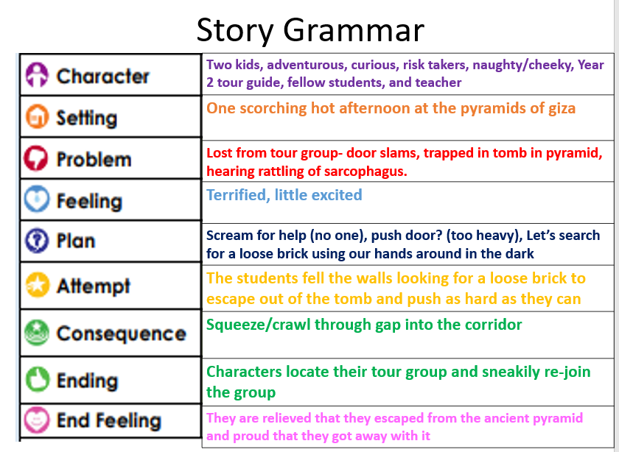

Slide 47
Editing and revising
Teacher Models Left Example,
Students Complete Right Example
Model Left
Read example
Students complete
WHOLE CLASS
Sam and Tess are adventurous, curious, risk takers who can be a little cheeky at times. One scorching hot afternoon at the pyramids of giza they found themselves lost from their tour group.
A door slams shut and trapped them into a tomb. They can hear rattling coming from a sarcophagus. Sam and Tess are terrified. Sam and Tess are a little excited.
Sam and Tess scream for help. No one can hear them. They push the door. The door is too heavy. They decide to search for a loose brick using their hands around in the dark. They feel the walls looking for a loose brick to escape out of the tomb and push as hard as they can. They manage to push the brick through and squeeze through a small gap into the corridor.
Sam and Tess locate their tour group and sneakily re-join the group.
STEPS
1. Read each sentence out loud.
2. Ask does this sentence make sense?
3. Check for the following:
-Included everything from your plan/in the correct order?
-Boundary punctuation/capital letters for proper nouns.
-Pronouns
-WWWWWH to expand sentences
-Rich vocabulary/adjectives/adverbs
-Expand simple sentences with conjunctions (because, but and so)
4-3
Notes:
WHOLE CLASS: edit from the PP each sentence using the steps as a guide (flick back to the plan to make sure everything is included) I.e. end feeling missing

